Slide 1
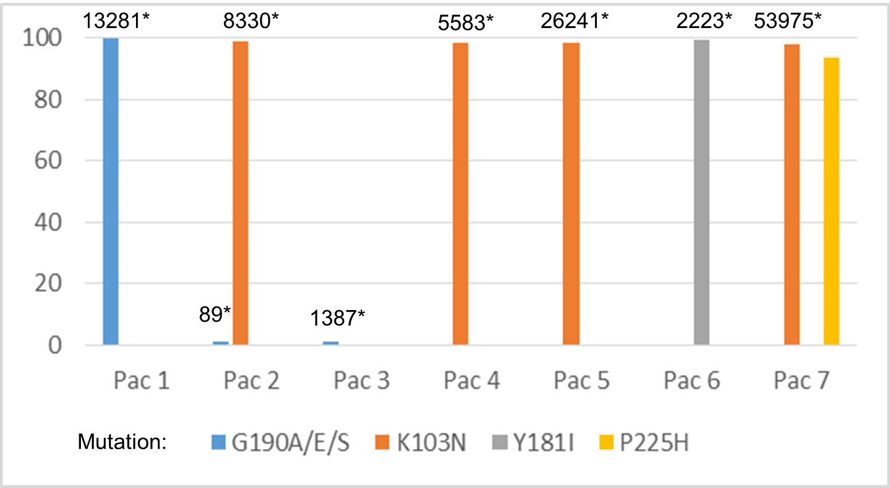
PEB0276
Reverse transcriptase and protease inhibitors mutational viral load in HIV infected pregnant women with transmitted drug resistance in Argentina
D. Cecchini¹, J. Sfalcin², I. Zapiola³, A. Gomez², S. Fernandez Giuliano³, L. Mammana³, A. Seravalle², Fay F², M.B. Bouzas³
¹Hospital Cosme Argerich, Infectious Diseases Unit, Buenos Aires, Argentina, ²CIBIC Laboratorios, Rosario, Argentina,
³Hospital Francisco J. Muñiz, Virology Unit, Buenos Aires, Argentina
Background:
Argentina has reported moderate to high levels of transmitted drug resistance (TDR), mostly to NNRTIs, in HIV-infected patients including pregnant women by standard sequencing.
However, the percentage of quasispecies harboring resistance mutations (RAMs) and mutational load (ML) remain unknown in those patients with TDR.
This information could be of importance in guiding the selection of maternal antiretroviral therapy and neonatal prophylaxis.
Material and Methods:
Retrospective study in a cohort of 40 naïve HIV-infected pregnant women, whose pretreatment samples had been genotyped by TRUGENE (period 2008-2014).
Samples were re-sequenced with Ultra Deep Sequencing (UDS) using a Public Health Agency of Canada protocol on Miseq sequencer (Illumina) and bioinformatics analysis were performed by HyDRA software for a 1% sensibility threshold.
TDR mutations were identified according to WHO guidelines. The ML was calculated in each patient considering baseline HIV-1 RNA load multiplied by the frequency of quasispecies harboring RAMs.
TDR mutations were identified according to WHO guidelines. The ML was calculated in each patient considering baseline HIV-1 RNA load multiplied by the frequency of quasispecies harboring RAMs.
Results:
By UDS, TDR for NNRTIs, NRTIs and PIs was 17.5% (n=7 patients), 10% (n=4), 12.5% (n=5) respectively.
Predominant NNRTI RAMs were K103N (n=4; 10%) and G190A/E/S (n=3; 7.5%).
For NNRTIs, 78% of RAMs were present in >93.5% of viral population and ML was >1000 c/mL for 89% of them, with a median (IQR) of 8330 c/ml (7738-29796).
A detail of the percentage of quasispecies harboring each NNRTI mutation and the corresponding viral load is shown in graphic 1.
The NRTI RAMs corresponded mostly to thymidine-analog associated mutations (7.5%) with a low prevalence of mutations in codon 184 (2.5%).
The following NRTI RAMs were described (per patient: % of quasispecies, ML):
T215I (99.7%, 11014 c/ml)
D67G (1.28%, 502 c/mL)
M41L (79.8%, 88578 c/mL)
M184I (1.02%, 173 c/mL)
Most frequent PI-RAMS were I85V, M46I, I50V and L90M (n=2, 5% each).
For PIs, quasispecies with RAMS corresponded to <2.3% of viral population and ML was <350 c/mL for 77.8% of them, with a median (IQR) of 191 c/ml (54-1274).
Percentage
*mutational viral load
Graphic 1. Percentage and mutational viral load of viral quasiespecies harboring NNRTI resistance in baseline samples of HIV-infected naive pregnant women in Buenos Aires, Argentina (2008-2014)
Conclusion: In this cohort of HIV-infected pregnant women, NNRTI-RAMs are predominant within the viral population, usually exceeding the threshold of 1000 c/mL, indicating potential higher risk of perinatal transmission. Conversely, PI mutations appear mostly as minority variants, with potential lower risk of transmission. Among NRTI, the percentage of quasispecies harboring RAMs and ML values were variable within the clinical samples.
PRESENTED AT THE 23RD INTERNATIONAL AIDS CONFERENCE (AIDS 2020) | 6-10 JULY 2020

